Slide 1



TR# 2017325

Slide 2



Certification
Skill Practice
2 – Certification
T-Mobile confidential and proprietary information. Not for customer distribution.

Slide 3

INTRO
Now, it’s time to put all your practice to good use!
It’s not one-and-done.
You’re in a safe environment.
Designed to demonstrate your knowledge.
3 – Certification
T-Mobile confidential and proprietary information. Not for customer distribution.

Slide 4
CERTIFICATION
1 HR 15 MIN
How it’s gonna work:
You’ll be divided into smaller groups of 3-5.
Each group will tag-team 3 skill practices (15 min each)
You will be called on randomly and more than once per scenario.
We’ll pause for feedback before the next person is tagged in.
4 – Certification
T-Mobile confidential and proprietary information. Not for customer distribution.

Slide 5
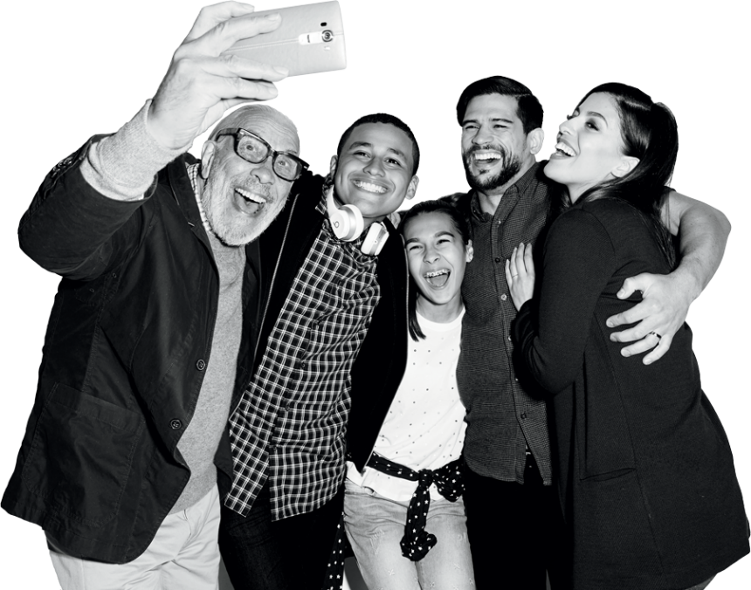
Certification
Demonstration
5 – Certification
T-Mobile confidential and proprietary information. Not for customer distribution.

